Slide 1
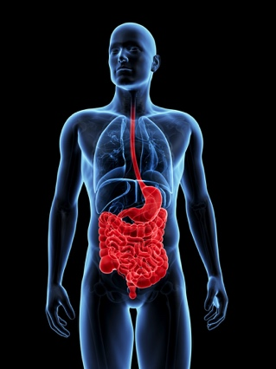











Multimedia and Medicine:
Teammates for Better Disease Detection and Survival
Michael Riegler, Mathias Lux, Carsten Griwodz, Concetto Spampinato, Thomas de Lange,
Sigrun L. Eskeland, Konstantin Pogorelov, Wallapak Tavanapong,
Peter T. Schmidt, Cathal Gurrin, Dag Johansen, Håvard Johansen, Pål Halvorsen

Slide 2
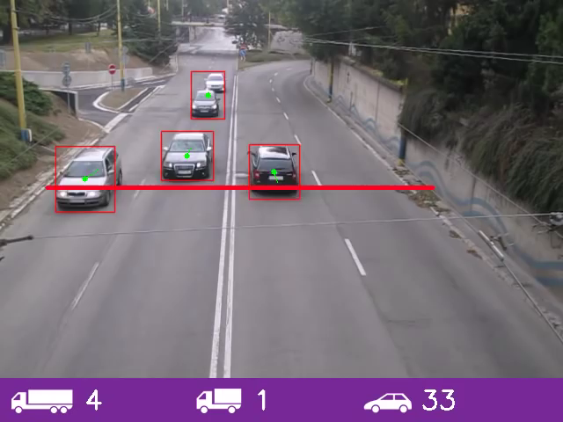
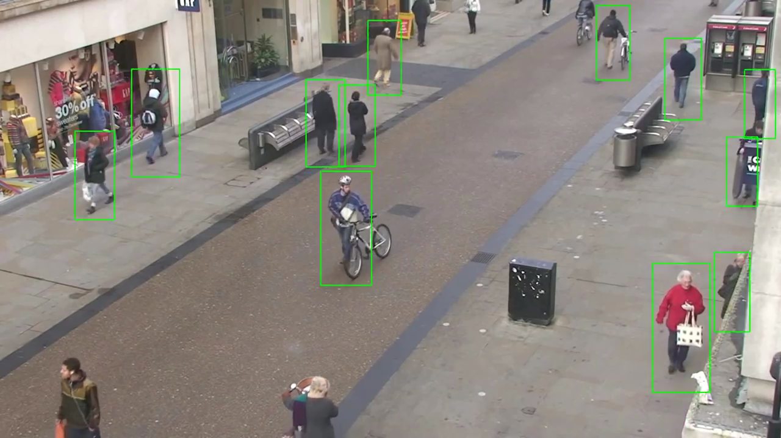
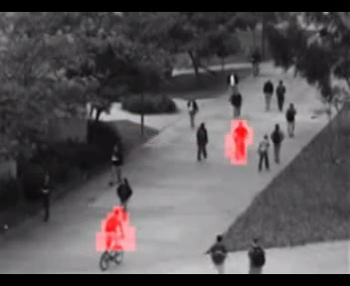

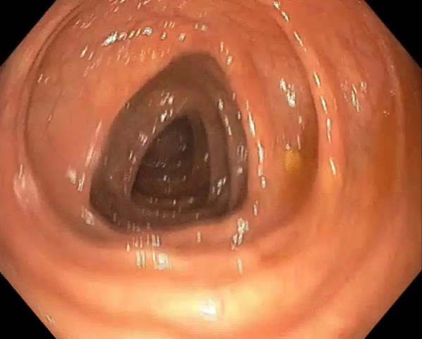
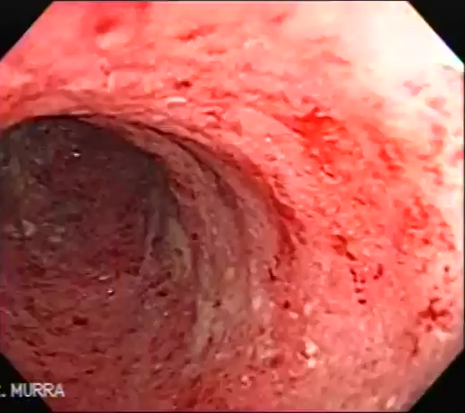
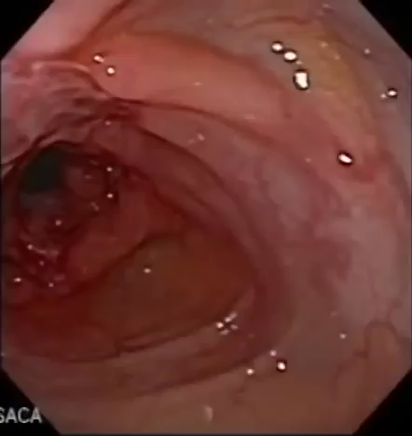
Multimedia & Medicine
Multimedia
Medicine (colon example)
systems, applications, information/image retrieval, machine learning, feature extraction, 3D reconstruction,
signal processing, real-time, scale, visualization, object/abnormality detection, social sensing, …
Medicine
Multimedia
polyp
Ulcerative colitis
Crohn's disease
Notes:
Multimedia has a lot already, but not the data and the domain expertize
Medicine has the domain expert knowledge, but technology as an integrated technical system is lacking. Varies between medical areas, but for GI tract, some polyp detection research, processing performance ignored, and only a video player output to doctors.
Doctor statement: lots of data of different types, don’t know how to get or analyze
Analyzing videos and images alone, beyond visual signal, does not solve the problem → multimedia research needed.

Slide 3
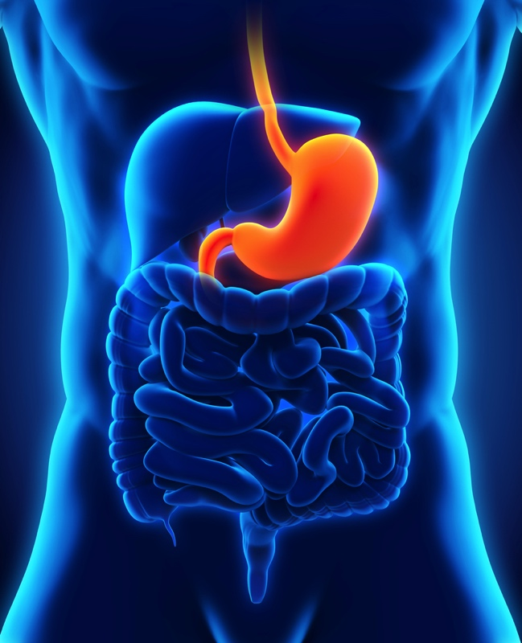
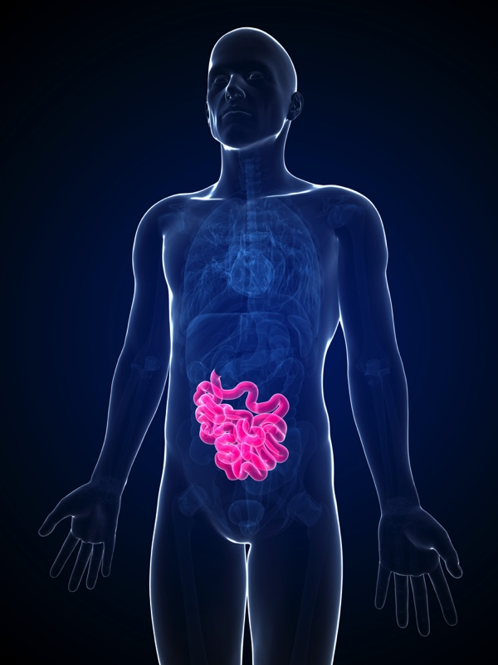
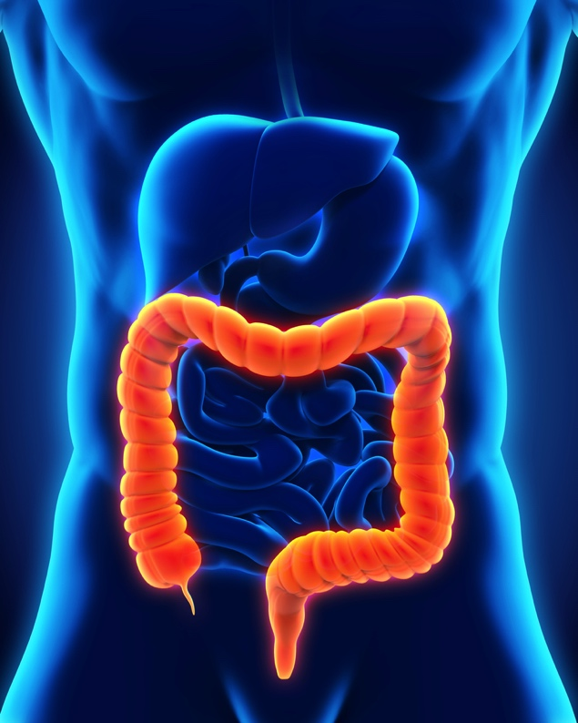
Case scenario:
Disease Detection in the Gastrointestinal Tract
Notes:
3 of the 6 most common cancer types are located in the GI tract
About 2.8 millions of new cancers (esophagus, stomach, colorectal) are detected yearly in the world, and the mortality is about 65%
stage 1: 90 % 5-year survivability, stage 4: 10 %

Slide 4

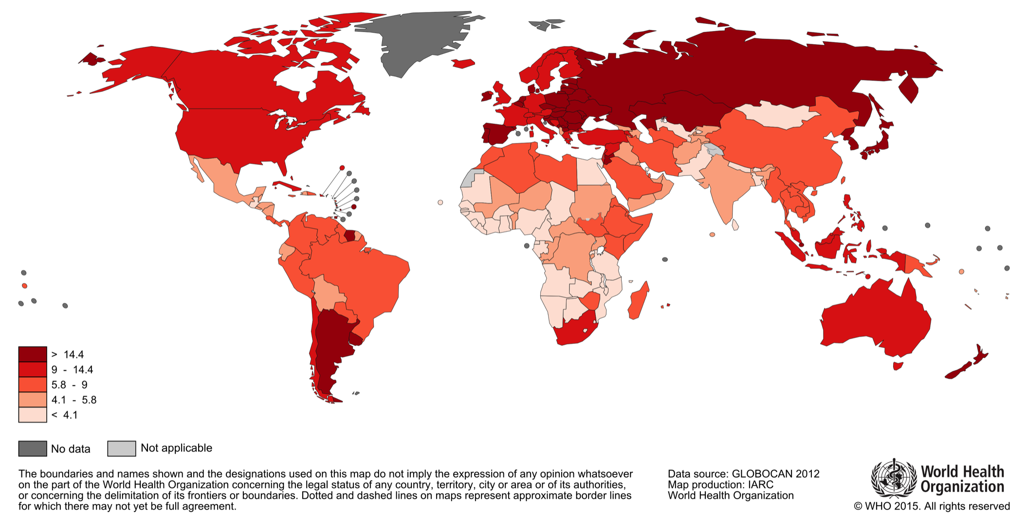

Estimated
Colorectal Cancer Mortality 2012 - Men
Most common cancer for men in Norway
Notes:
Estimated age-standardised rates (World) per 100,000

Slide 5
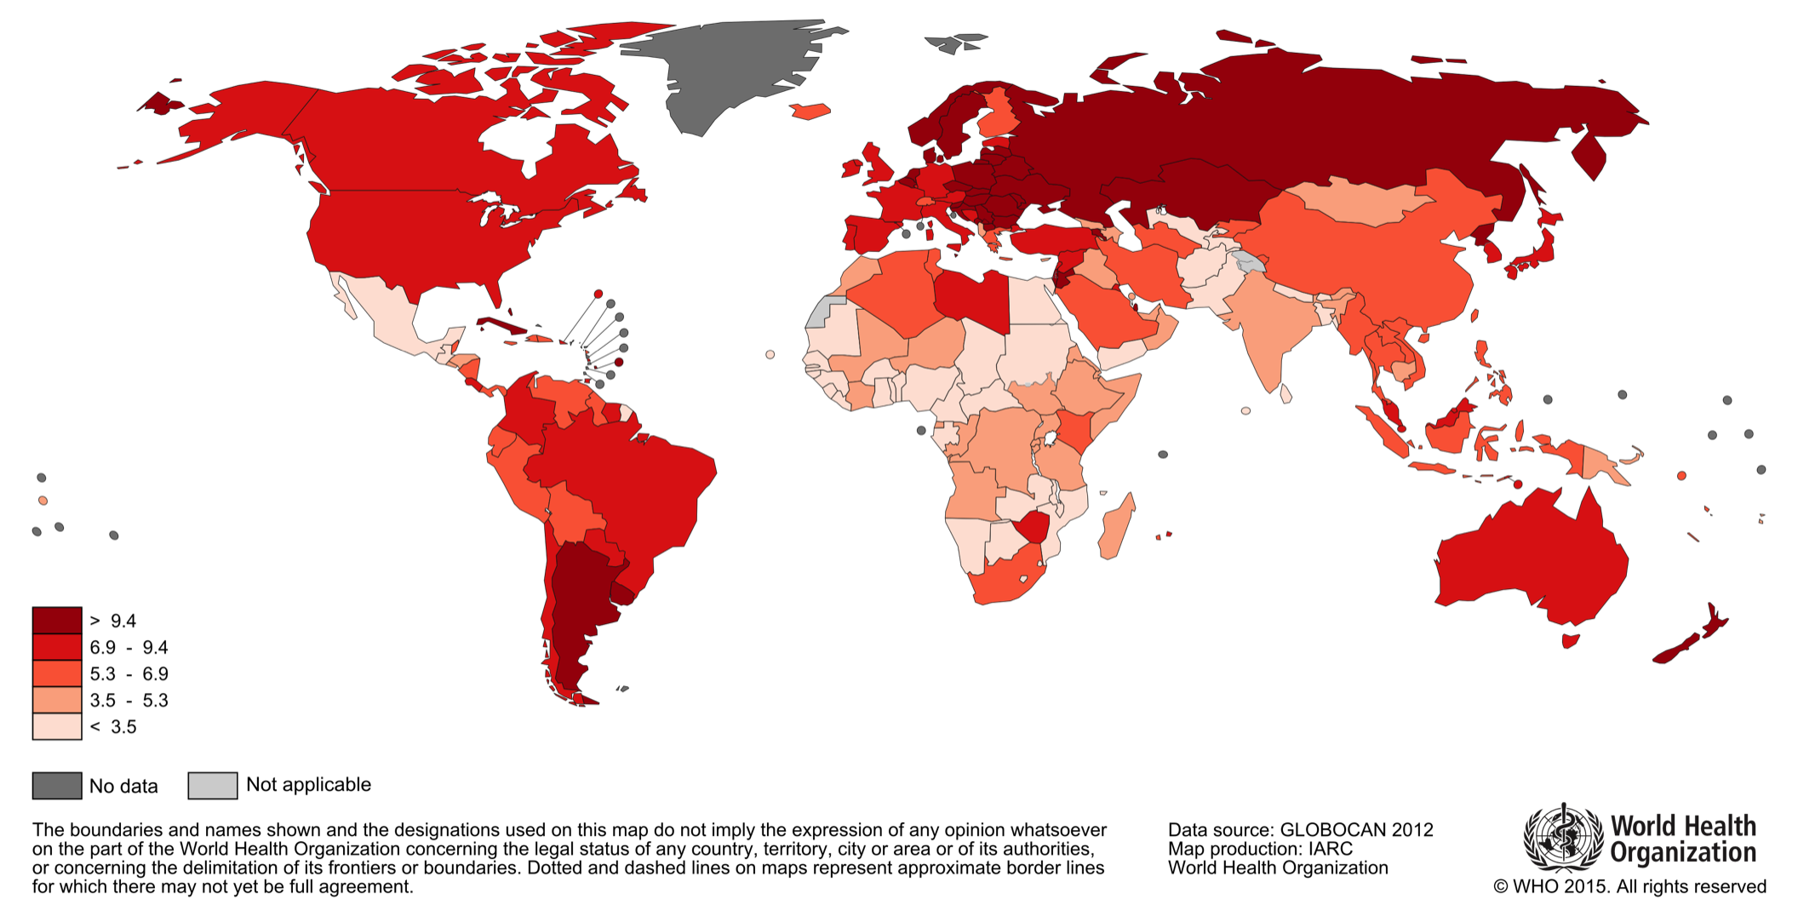

Estimated
Colorectal Cancer Mortality 2012 - Women
Second most common cancer for women in Norway
Notes:
Estimated age-standardised rates (World) per 100,000

Slide 6
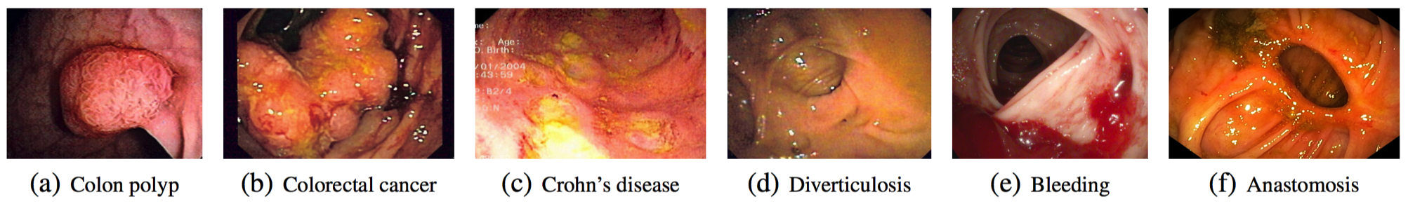
GI Tract Challenges
Many types of diseases can potentially affect the human digestive system
Screening of the gastrointestinal (GI) tract using different
types of endoscopy…
  is costly (colonoscopy: US - $1100/patient, $10 billion dollars)
  consumes valuable medical personnel time (1-2 hours)
  does not scale to large populations
  is intrusive to the patient
  …
Current developments in technology may potentially enable
automatic algorithmic screening and assisted examinations
→ a true interdisciplinary activity with high chances of societal impact

Slide 7
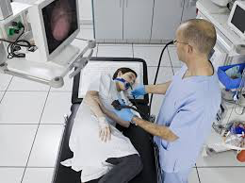
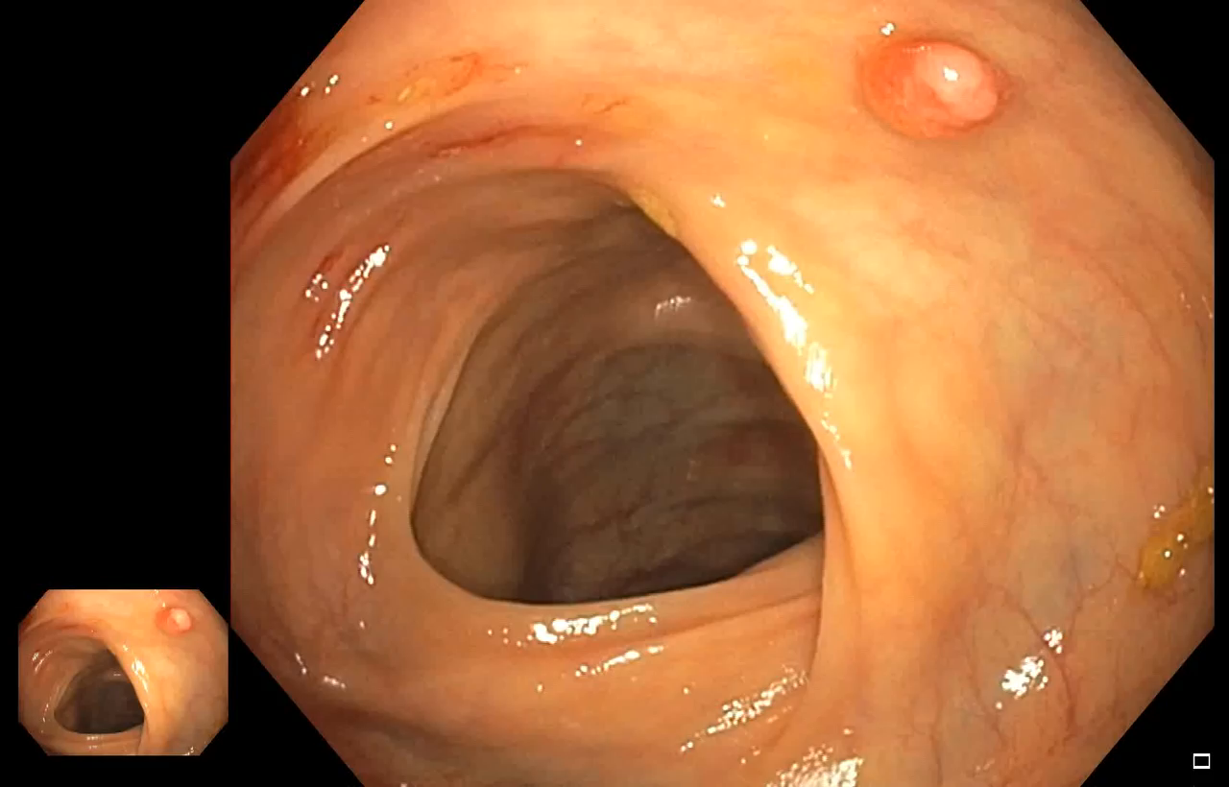
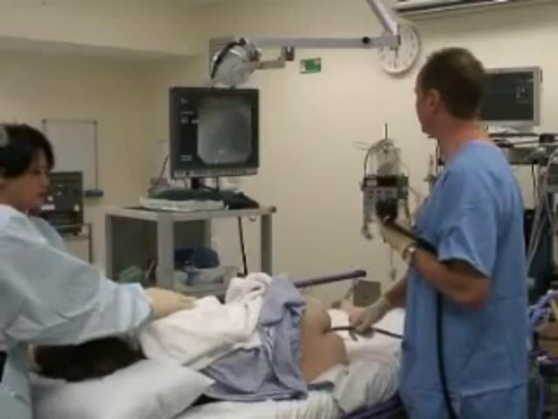
Live Automatic Detection
System to assist doctors during live endoscopy procedures
  detection accuracy depend on experience and skills
    doctors often miss abnormalities during an endoscopy examination, e.g.,
    up to 20% of polyps in the colon [1]
  have a “second eye”,
  “better” detection
[1] van Rijn, J. C., Reitsma, J. B., Stoker, J., Bossuyt, P. M., van Deventer, S. J., and Dekker, E.
Polyp miss rate determined by tandem colonoscopy: a systematic review.
The American journal of gastroenterology 101, 2 (2006)

Slide 8
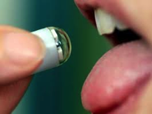
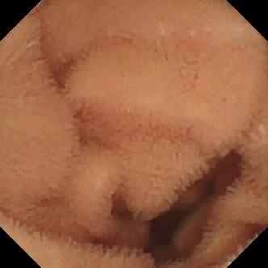
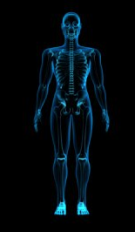
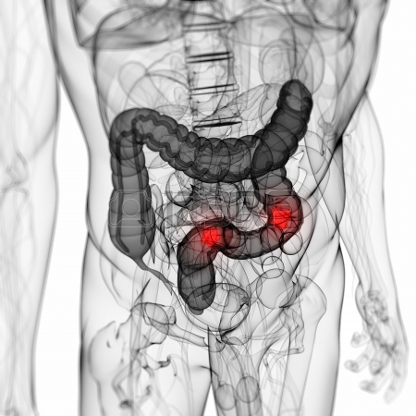
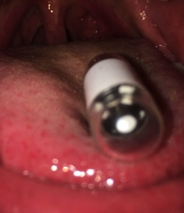
Wireless Video Capsule (PillCam)
expensive
does not scale
intrusive
better scale
less intrusive
possible to combine examinations!?
less expensive?
(detection might lead to an endoscopy)

Slide 9
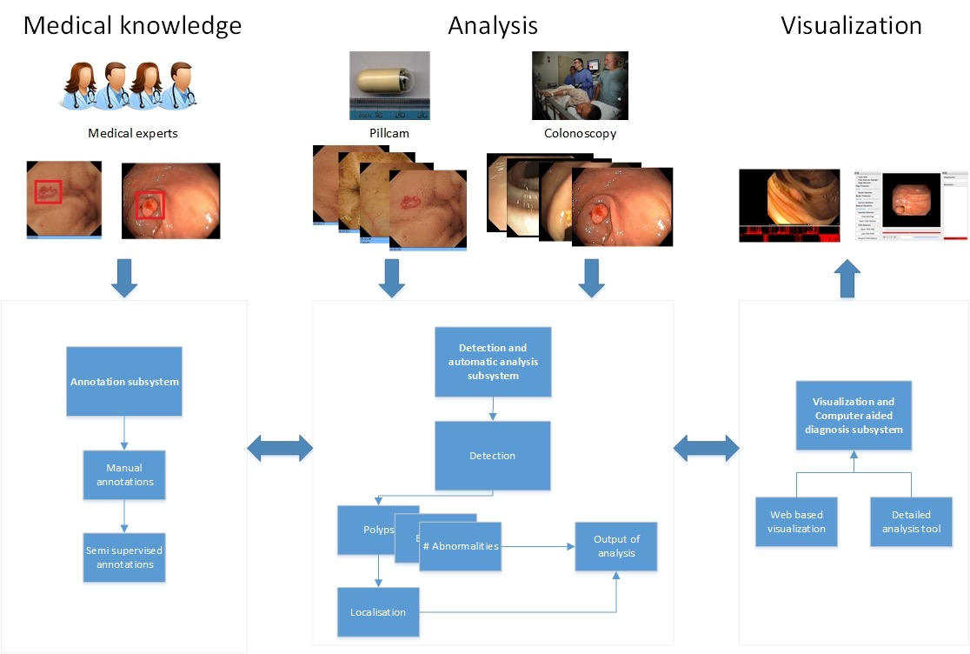
Eir overview
Notes:
Color and Edge Directivity Descriptor
FCTH Fuzzy Color and Texture
Late fusion

Slide 10
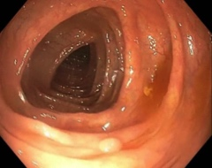
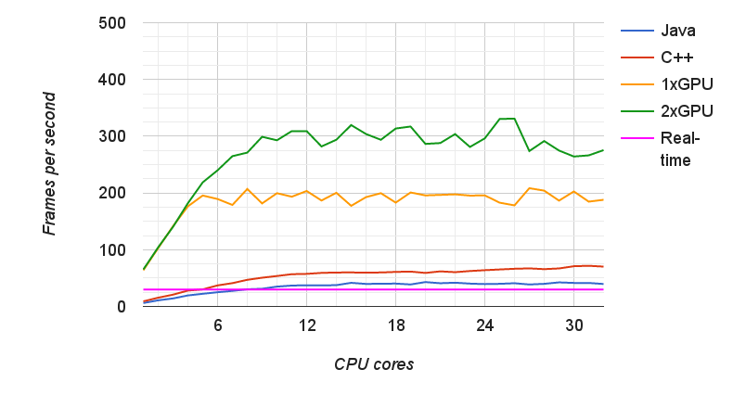
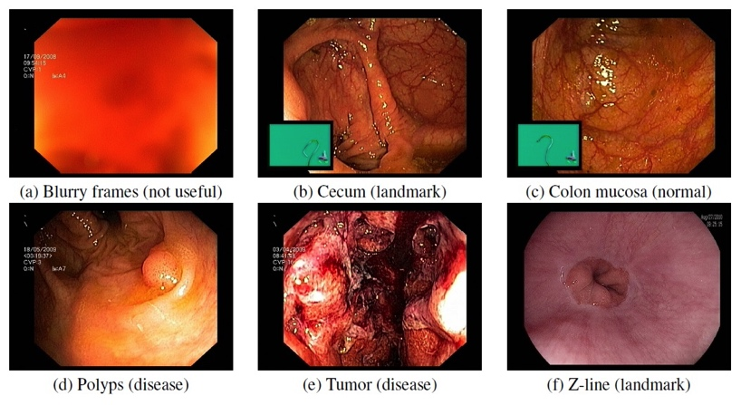
Eir detection performance
ASU MAYO dataset
  polyps
  global features
    recall: 98.50%, precision: 93.88%, fps: ~300
  neural networks
    recall: 95.86%, precision: 80.78%, fps: ~40
  no memory limitations
Vestre Viken multi-disease dataset
  polyps, z-line, cecum, colon mucosa, tumor
  global features
    recall: 96.90 %, precision: 90.60%, fps: ~30
  neural networks
    recall: 95.70%, precision: 87.20%, fps: ~30
Notes:
memory: had up to 32 GB available, used maximum 1 GB…

Slide 11
Open Challenges
Improve detection, localization and system performance
(retrieval, machine learning, features, search, real-time, distributed computing, scale, visualization, neural networks,
user interaction, object tracking, …)
Exploiting domain expert knowledge – build data sets
Integration of various data, multi-modality – new sensors
Automated report system
Patient context information
Visualization, decision support
Other areas in medicine
…
Multimedia and Medicine:
Teammates for Better Disease Detection and Survival

Slide 12

Questions?? Comments?? Ideas??
Multimedia
Medicine

